Slide 1



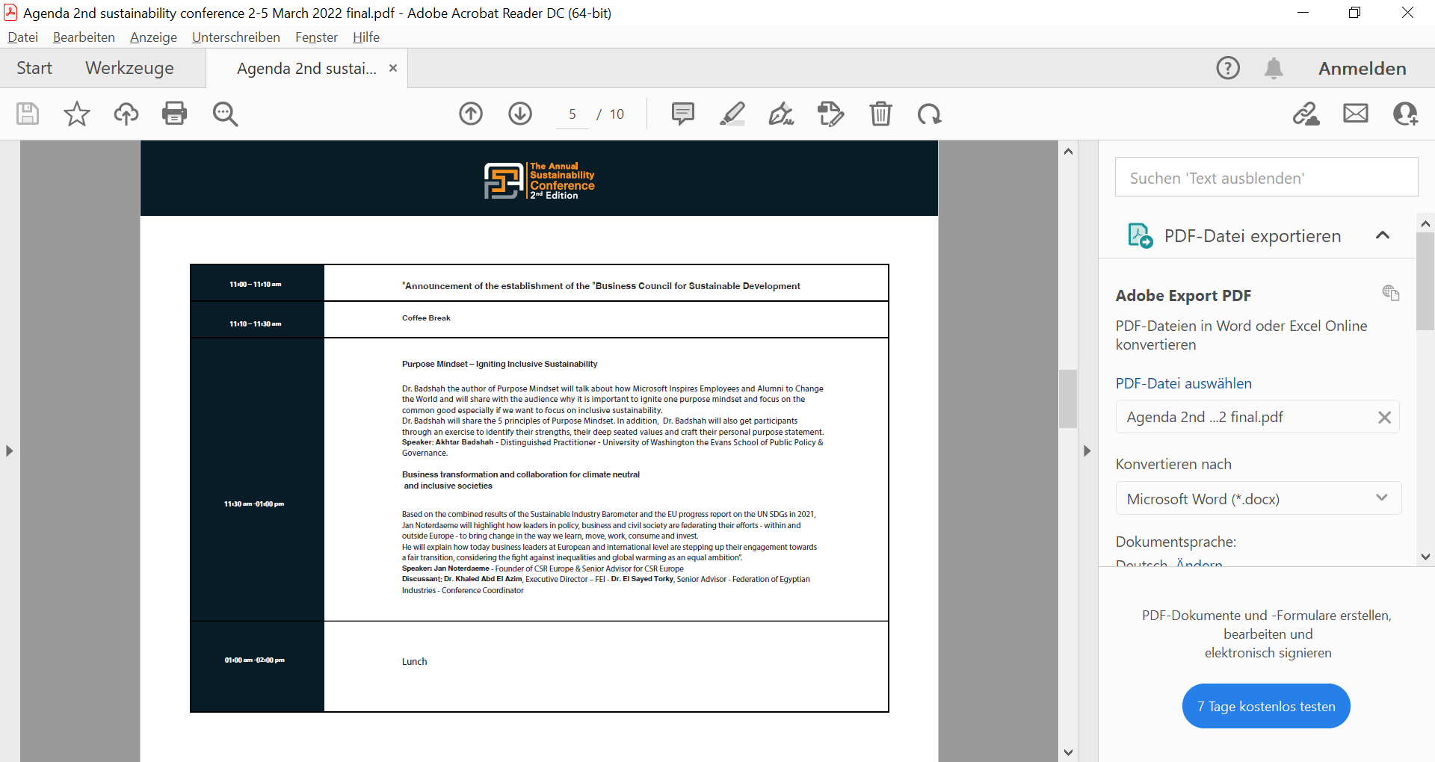
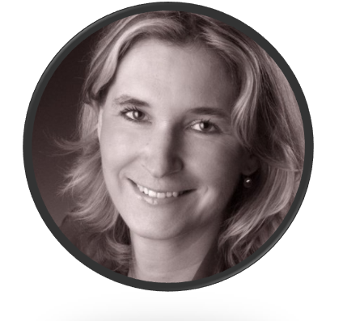
The Annual Sustainability Conference 2nd Edition
CAMPUS KÖLN
CAMPUS MAINZ
CAMPUS POTSDAM
The power of education for a smooth sustainable transformation
e.froehlich@cbs.de

Slide 2

Table of Contents
The Call for Value-Based Management …
The Power of Education: Principles to follow
Innovative teaching formats: The SDG Teaching Map
How to exploit the power of education

Slide 3

THE CALL FOR VALUE-BASED MANAGEMENT

Slide 4
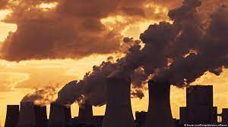
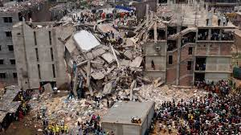
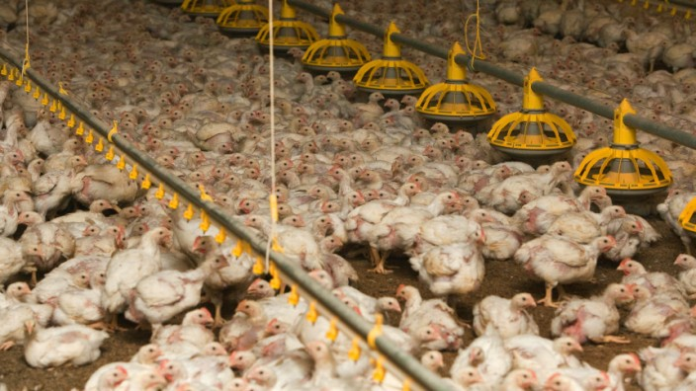
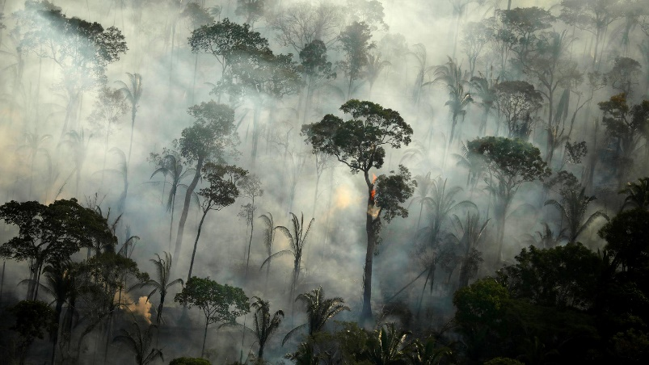
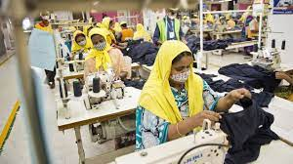
Our world is on fire …

Slide 5
We are gambling away our livelihood
Loss of biodiversity: The call for value-based management
Use & exploitation of nature
Direct causes:
Changed land and sea use (e.g. monocultures)
Exploitation of species (e.g. fishing)
Climate change
Indirect causes:
Increasing human population
Increase in resource used per person
Course of action
Fundamental transfor-mation of society
Effective protection of land and marine areas by 2030
Rethinking agriculture
Development of biodiversity-friendly farming methods
Effective marketing of biodiversity-friendly food (change in consumer buying behavior)
Turnaround is possible
Immediate implementation of a portfolio of measures consisting of:
more protected areas
Efficient use of agricultural areas
Change in consumer buying patterns
Reduction of food waste
Immediate, informed, system-wide and joint action is needed!
Forschung und Lehre, 5/2021, S. 356 ff.

Slide 6
Why is education so powerful?
„Education means more than acquiring knowledge. It empowers people to develop personally …“ (Deutsche Welle)
“Transformative power of a great education can change everything”. (Nelson Mandela)
“Education is … designed to develop and raise future leaders and indeed, a new generation of leaders that will change the society for the better” (Babalola).
Education is needed to develop “a sense of social responsibility, as well as strong and transferable intellectual and practical skills such as communication, analytical, and problem-solving skills” (Janet Eyler)
„Learning has been identified as a critical tool for the achievement of sustainable development as a whole, and to the UN SDG in particular” (Filoh)

Slide 7
Why is education so powerful?
“Education is the most powerful weapon which you can use to change the world”. (Nelson Mandela)
“Business schools are perfectly positioned to influence sustainability, yet their role is both under-appreciated and insufficiently developed”. (Giselle Weybrecht)

Slide 8
THE POWER OF EDUCATION: PRINCIPLES TO FOLLOW

Slide 9
Unleashing the power of education
“First and foremost, the best education should confer the power to examine, know and change ourselves, so that we might transform the lives of others”.
Inquiry and Wholeness
Expanding Knowledge and Transcendence
Pluralism and dynamic outreach
The schooling regime
Narrative Fallacies and Misperception
Realising Human Potential
Excellence with a soul
Jeremy Henzell-Thomas, 2018

Slide 10
The seven principles of Sustainable Leadership
Sustainable leadership creates and preserves sustaining learning
Sustainable leadership secures success over time
Sustainable leadership sustains the leadership of others
Sustainable leadership addresses issues of social justice
Sustainable leadership develops rathe than depletes human and material resources
Sustainable leadership develops environmental diversity and capacity
Sustainable leadership undertakes activist engagement with the environment
Hargraeves & Fink, 2003

Slide 11
INNOVATIVE TEACHING FORMATS: The SDG TEACHING MAP

Slide 12
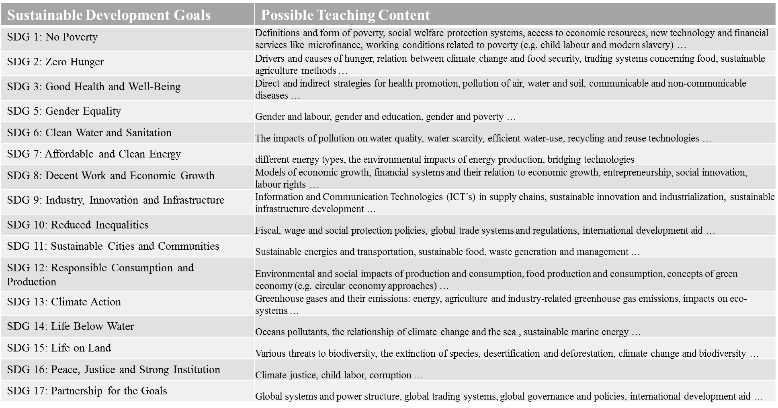
The SDG Teaching Map: Which SDGs can be addressed in teaching?
Own illustration based on UNESCO (2017) Education for Sustainable Development Goals: Learning objectives. UNESCO, Paris

Slide 13
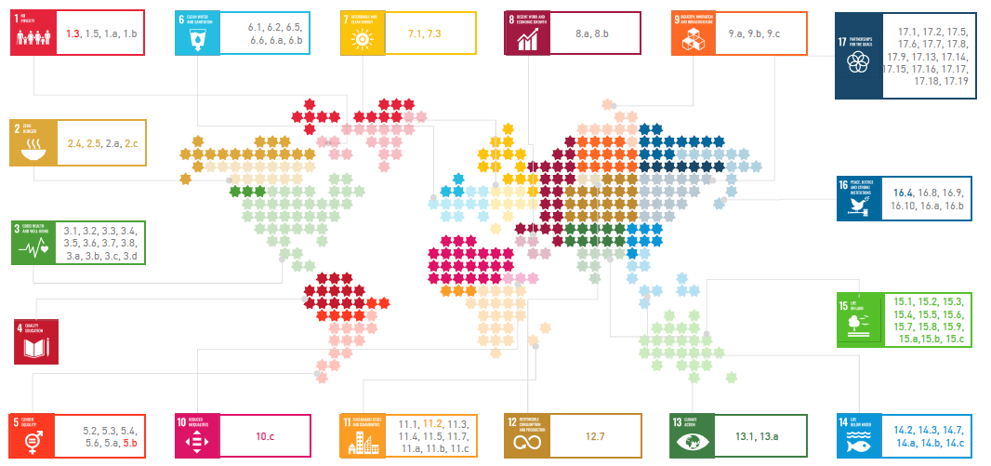
The SDG Teaching Map: The CBS International Business School Case
Fröhlich & Kul, 2019

Slide 14
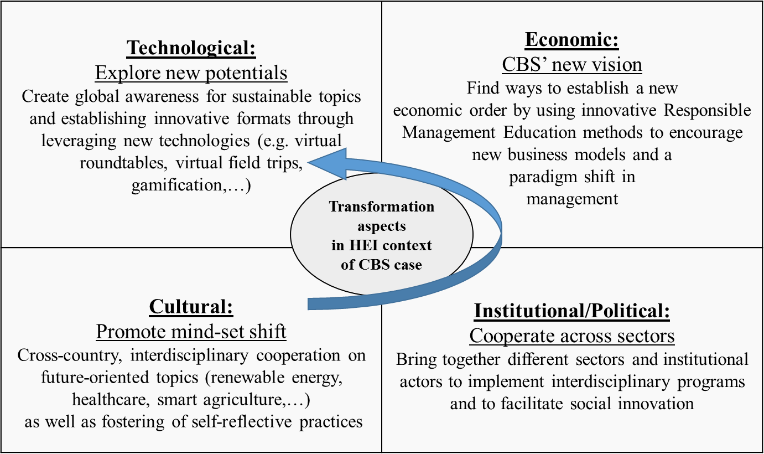
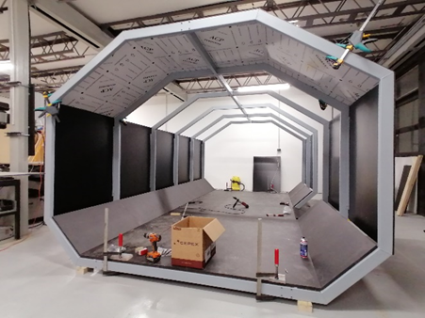

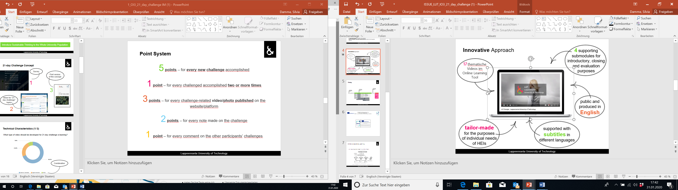
The Future Art Model: A Guideline to implement innovative teaching formats for RME
Need for (international) collaboration of HEIs for format and curriculum development
Need for building bridges to businesses and politics to successfully implement Agenda 2030
Need for adopting an outside-in perspective that goes beyond the triple bottom line
Need for changing cultural aspects of our current economic system and all its stakeholders
Future Sustainability Manager
Own illustration based on Schneidewind U, Rehm A (2019) Vom inside-out zum outside-in : Perspektivwechsel bei der Impact-Messung von transformativer Forschung. GAIA - Ecological Perspectives for Science and Society, p.169

Slide 15
HOW TO EXPLOITE THE POWER OF EDUCATION

Slide 16


Our duties as educators …
We need to understand WHAT and HOW we have to teach in the context of sustainable transformation.
Education as a matter of course
Education as a chance to grow
people need inspiration
people need access to education
Two major tasks:
Experiential Learning
Lifelong Learning

Slide 17
… to make our world a better place!
„You will be better and your family will be better if you have quality education;
Your town will be better if you have quality education;
Your nation will be better if you have quality education; and finally
The world will be better if we have quality education“.
Aare Afe Babalola 2022

Slide 18
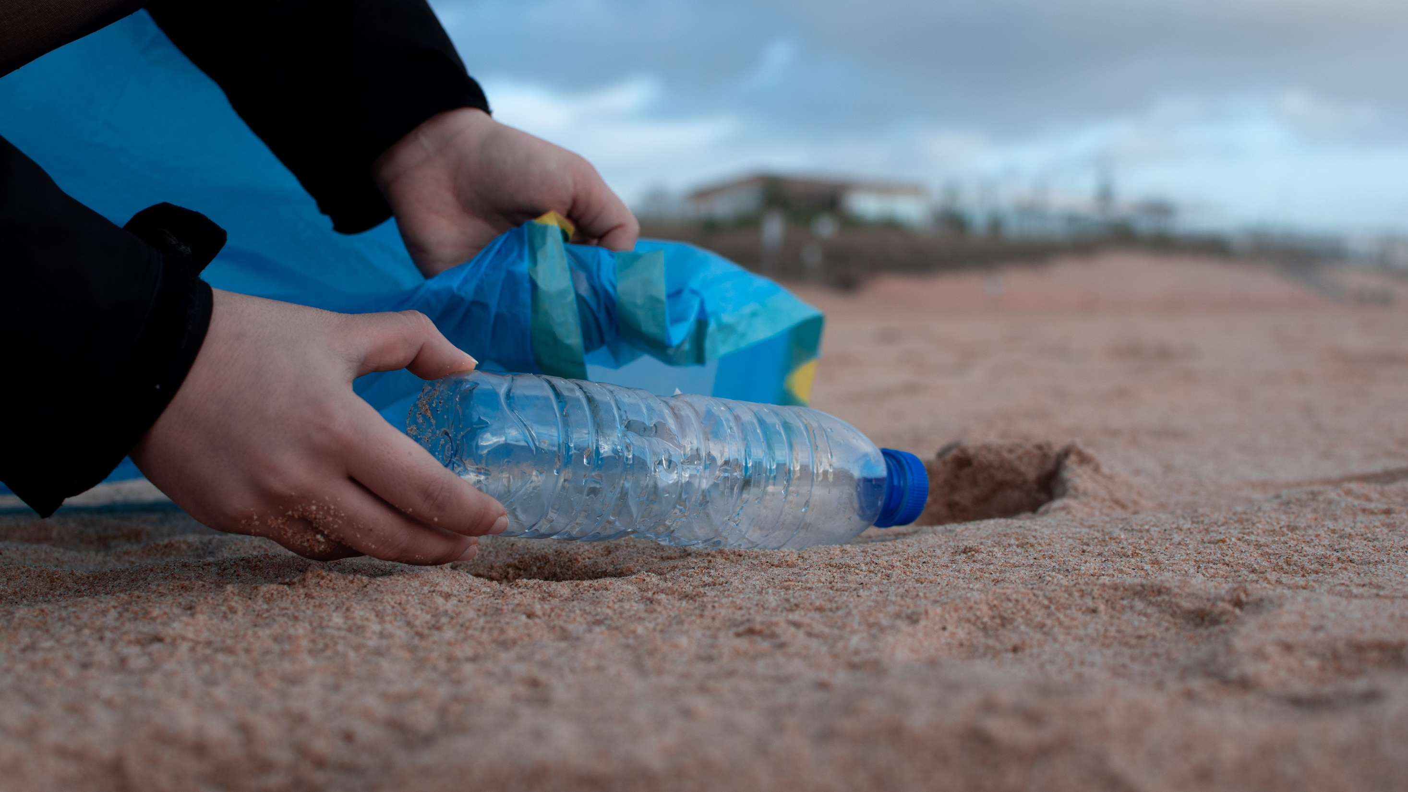
CAMPUS KÖLN
CAMPUS MAINZ
CAMPUS POTSDAM
Let’s join forces to tackle the educational challenges for sustainability!

